Slide 2
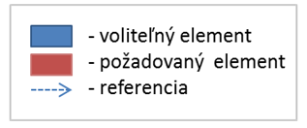
subjectInfo
1
title
1.. *
objective
0..1
additionalInfo
0..1
0..1
0..1
conditions
scores
max
0..1
presenter
min
0..1
1.. *
instructor
assignments
assignment
1.. *
0..1
1.. *
resource

